Slide 1
Psychological Disorders
Chapter 15

Slide 2
Agenda
Classifying Disorders
Perspectives on Disorders
Anxiety Disorders
Obsessive Disorders
Stress and Mood Disorders
Dissociative Disorders
Disorders in Childhood
Personality Disorders

Slide 3
What is a psychological disorder?
Psychological disorder: “a syndrome characterized by clinically significant disturbance in an individual's cognition, emotion regulation, or behavior that reflects a dysfunction in the psychological, biological, or developmental processes underlying mental functioning. Mental disorders are usually associated with significant distress in social, occupational, or other important activities” (APA,2013).
Psychopathology: the study of psychological disorders, including their symptoms, etiology (i.e., their causes), and treatment.

Slide 4
Medical Student Disease

Slide 5
What makes a behavior atypical?
All behaviors are on a spectrum. The behaviors seen in psychological disorders are those that fall more to one side of the spectrum or the other. The “unusualness” is impacted by the culture and situation. For an example, look at this spectrum of anxious behavior:
Doesn’t react to any stressful situations; cold and aloof
Won’t leave the house due to fear of stressful situations
Will get stressed out, but can manage that stress

Slide 6
American Psychiatric Association
There are significant disturbances in thoughts, feelings, and behaviors.
The disturbances reflect some kind of biological, psychological, or developmental dysfunction.
The disturbances lead to significant distress or disability in one’s life.
The disturbances do not reflect expected or culturally approved responses to certain events.

Slide 7
Classification Systems
Diagnostic and Statistical Manual of Mental Disorders (DSM-5)
International Classification of Diseases (ICD)

Slide 8
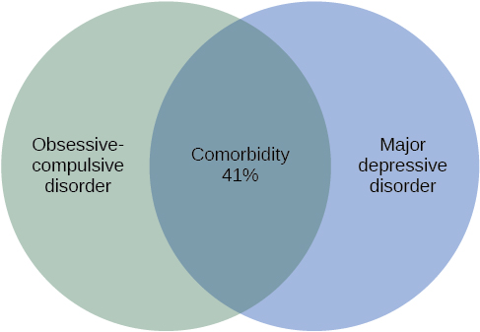
Comorbidity – An Important Aspect of Diagnostics

Slide 9
Perspectives of Psychological Disorders
The supernatural perspective
The biological perspective
The diathesis-stress model

Slide 10
Anxiety Disorders
Specific phobia (acrophobia, claustrophobia, ophidiophobia)
Social anxiety disorder
Panic disorder and panic attacks
Generalized anxiety disorder

Slide 11
Obsessive Disorders

Slide 12
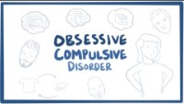
Obsessive-Compulsive Disorder (OCD)
https://www.youtube.com/watch?v=I8Jofzx_8p4&t=2s

Slide 13

Body Dysmorphic Disorder

Slide 14
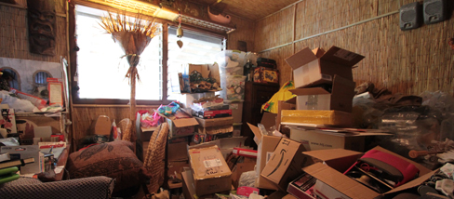
Hoarding Disorder

Slide 15
Stress and Mood Disorders

Slide 16
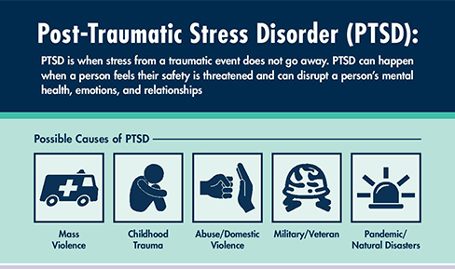
Posttraumatic Stress Disorder (PTSD)

Slide 17
Depression
Major depressive disorder
Suicidal ideation
Seasonal affective disorder
Postpartum depression
Persistent depressive disorder

Slide 18
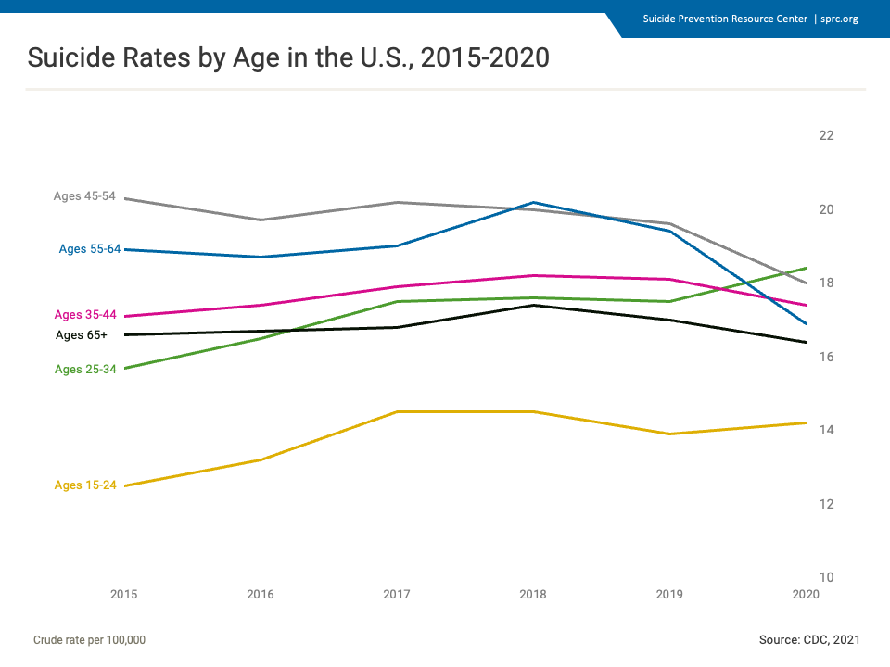
Suicide

Slide 19
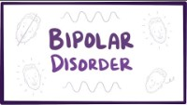
Bipolar Disorder
https://www.youtube.com/watch?v=KSvk8LLBo2g&t=2s

Slide 20
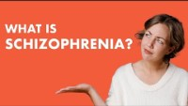
Schizophrenia
https://www.youtube.com/watch?v=k3WP0vT0Pv4&list=PLDgFtG7YA9Y5b_E2282_izNmYqLt0rvFW&t=1s

Slide 21
Dissociative Disorders
Dissociative Amnesia
Depersonalization/ Derealization Disorder
Dissociative Identity Disorder

Slide 22
Disorders in Childhood – Neurodevelopmental Disorders

Slide 23
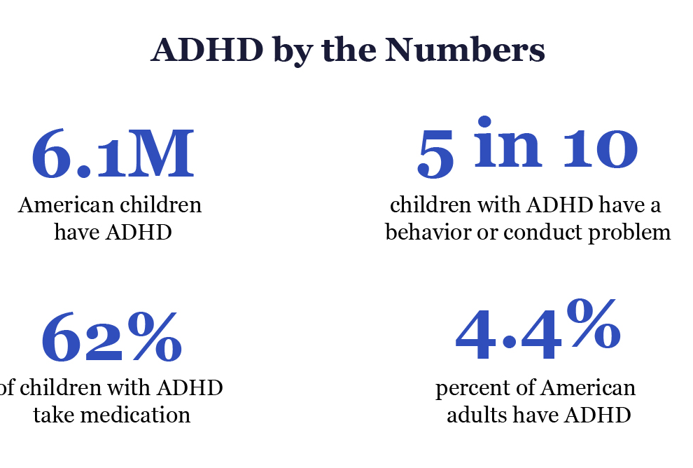
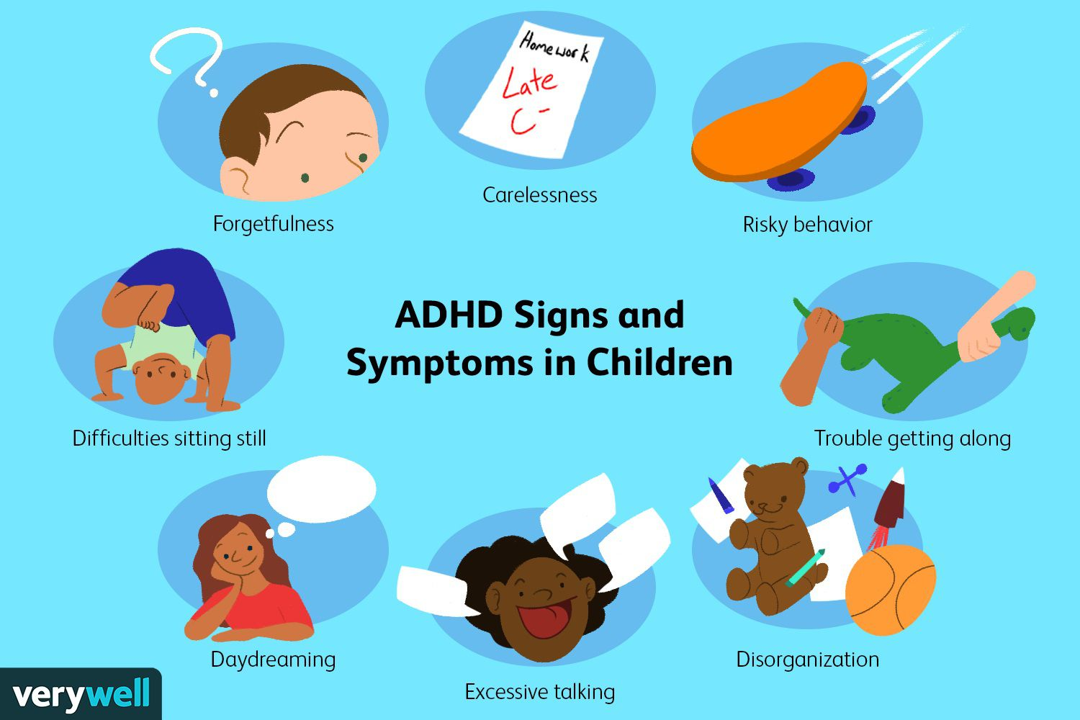
Attention Deficit/ Hyperactivity Disorder

Slide 24
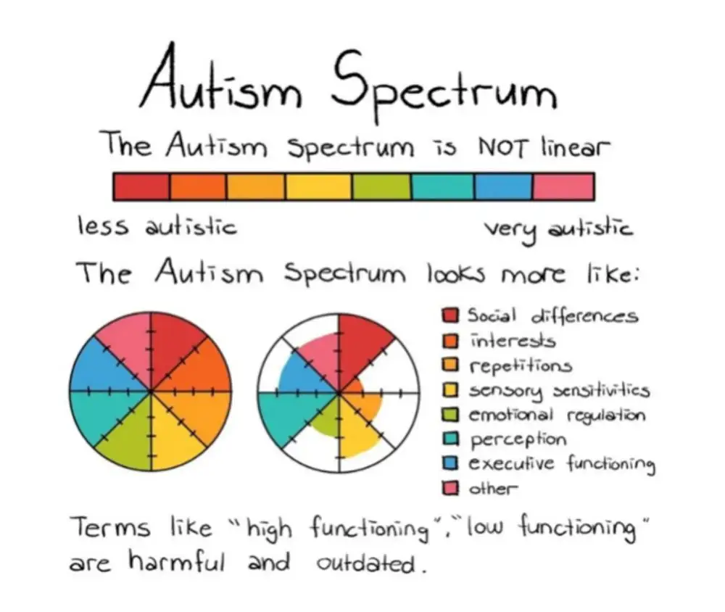
Autism Spectrum Disorder (ASD)

Slide 25
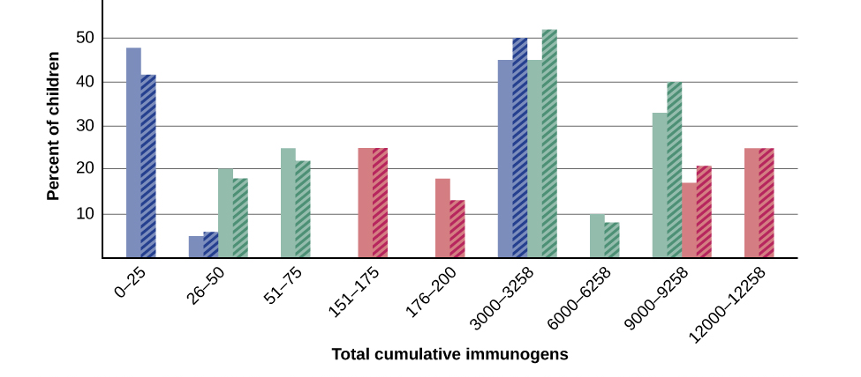
Vaccines and ASD

Slide 26
Personality Disorders

Slide 27
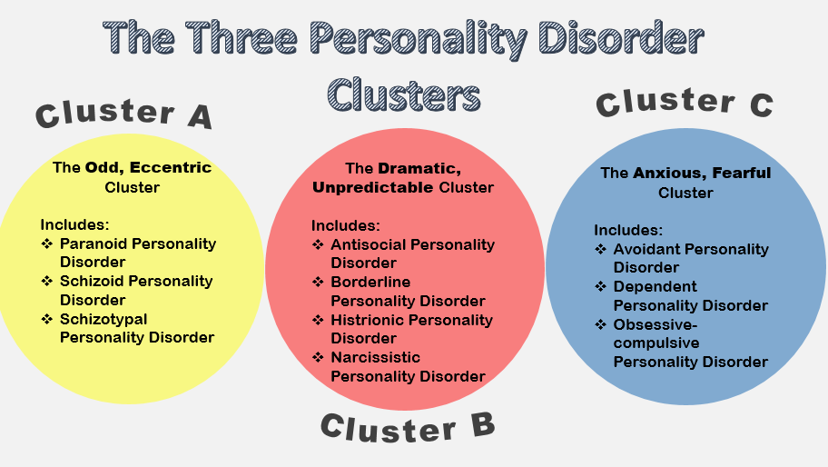
Personality Disorder Clusters

Slide 28
Antisocial Personality Disorder
Antagonism
Disinhibition
Attention-seeking behavior
Low anxiousness
Diminished empathy

Slide 29
(Some) Categories of Disorder
Learning disorders
Ex: dyslexia and dyscalculia
Neurodevelopmental disorders
Ex: ADHD and autism
Anxiety disorders
Ex: generalized anxiety disorder
Obsessive-compulsive related disorders
Ex: obsessive-compulsive disorder & hoarding disorder
Dissociative disorders
Ex: dissociative identify disorder

Slide 30
(Some) Categories of Disorder
Mood disorders
Ex: bipolar disorders
Ex: Bipolar Type I
Ex: depression disorders
Ex: Major depressive disorder
Psychotic disorders
Ex: schizophrenia and schizotypal personality disorder**
Personality disorders
Cluster A disorders
Ex: Schizotypal personality disorder**
Cluster B disorders
Ex: Borderline personality disorder
Cluster C disorders
Ex: Obsessive-compulsive personality disorder

Slide 31
Class Activity: Questions for Step 2
Note: Must answer AT LEAST THREE of these questions:
What is the definition of this disorder?
What are the symptoms?
At what age can it be diagnosed?
Are there any trends or risk factors for who has this disorder (more females than males, genetic components, etc.)?
What percentage of the population have this disorder?
How is this disorder treated/ managed?
Are there typical comorbidities for this disorder?

Slide 32
Next time on PSY 203…
BEFORE NEXT CLASS:
NEXT CLASS:
Complete homework assignment
Due next Tuesday at 11:59pm
Email me ASAP if you have questions
Read Chapter 16
Research points (due 4/30)
Chapter 16 – Therapy and Treatment

